Slide 1

Microservices – Spring Boot
Security
- Guru

Slide 2
Agenda
OAuth
JWT
Creating spring boot project
Generating private and public keys
Generating access token
Accessing the restricted resources using the access token

Slide 3
What is OAuth?
Open Authorization
OAuth allows notifying a resource provider (e.g. Facebook) that the resource owner (e.g. you) grants permission to a third-party (e.g. a Facebook Application) access to their information (e.g. the list of your friends).
This is without exposing the password
OAuth2 is just a version of OAuth

Slide 4
OAuth – Another example
You have a gmail account
You have Linkedin account
If you want to add all of your gmail users into Linkedin, how tiresome it would be?
So, you will be giving open authorization to Linkedin so that Linkedin will now access all of your friends list from gmail and add them to Linkedin automatically.
This is how FB and other websites accesses our information (but only if we permit)

Slide 5
What is JWT?
Stands for JSON Web Token
way for securely transmitting information between parties as a JSON object.
It is used as a single sign on mechanism
Once you login into a particular website, then you can start accessing all permitted other services without re-login
So, JWT is used for authorization

Slide 6
Create a spring boot project
Project name: oauth2-demo
You can choose any one of the methods to create Spring Boot project:
Using maven project (add the dependencies)
Create a Spring Starter Project (add the dependencies)
Go to the website: https://start.spring.io/
Generate the project, download and import as Existing maven project

Slide 7
The parent project
<parent>
<groupId>org.springframework.boot</groupId>
<artifactId>spring-boot-starter-parent</artifactId>
<version>1.5.9.RELEASE</version>
<relativePath />
</parent>

Slide 8
Maven Dependencies
We need the following dependencies in Maven:
spring-boot-starter-jdbc
spring-boot-starter-security
spring-boot-starter-web
spring-security-oauth2
spring-security-jwt
Oracle Version 11.2.0.2.0

Slide 9
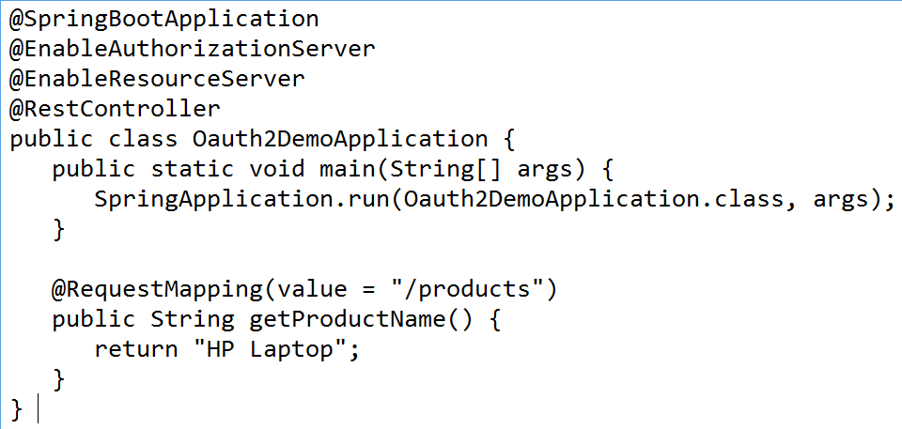
Spring Boot main class

Slide 10
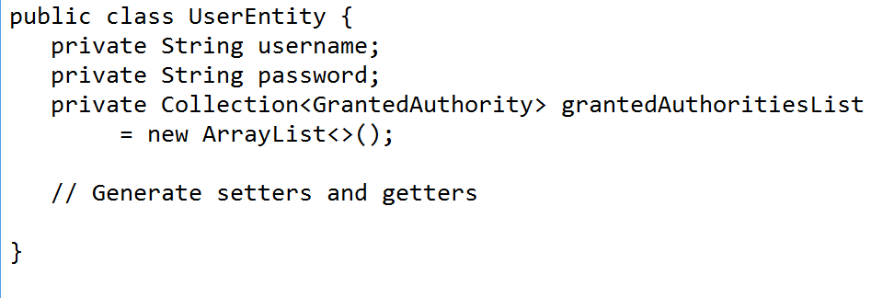
POJO class
We need to create a POJO class to store the User information for authentication

Slide 11
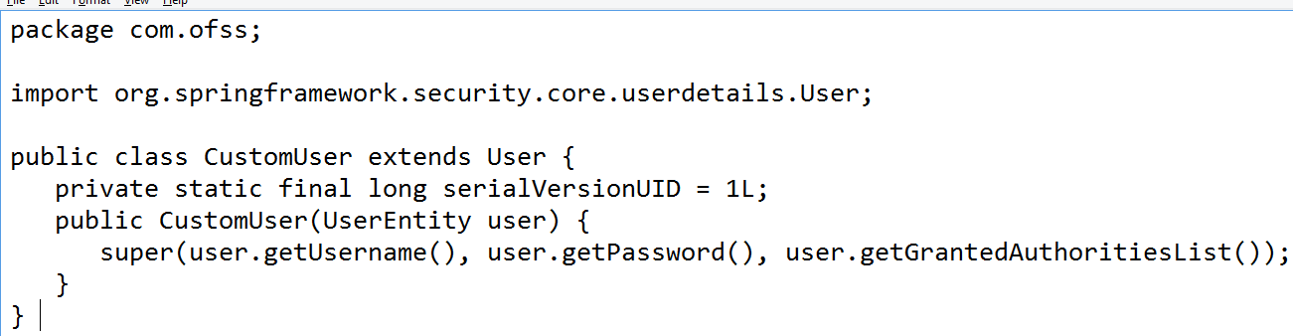
Class for Spring Boot Authentication

Slide 12
Repository class to read credentials from ORACLE DB
Let’s call it as OAuthDao
We mark it with @Repository
Autowire jdbcTemplate
We will get the username, password from the DB table “users” by executing SELECT * FROM USERS WHERE USERNAME=?
Also, we will specify the authority name such as “ROLE_ADMIN”
Complete code is available in google drive

Slide 13
Create Service class
Create a class “CustomerDetailsService” and annotate this with @Service
Let it implement UserDetailsService
This will get the UserEntity object from the DAO class we have written
Then, we will encapsulate this object into CustomUser class’s constructor to get its object

Slide 14
Create Configuration Class
We need to now enable the web security
This is very similar to the one we have seen in Spring Security
We will be extending from WebSecurityConfigurerAdapter class
If you remember, this has overloaded methods configure(), one with AuthenticationManagerBuilder parameter and another with HttpSecurity

Slide 15
Create Configuration Class
In the 1st configure method, we will be using “userDetailsService” method and passing object of CustomerDetailsService
Also, we will use the object of BCryptPasswordEncoder for encoding the password

Slide 16
Create Configuration Class
In the 2nd configure method, we will specify which request needs to be authorized
Let’s specify that all requests need to be authorized
@Override
protected void configure(HttpSecurity http) throws Exception {
http.authorizeRequests().anyRequest().authenticated(); }

Slide 17
Create Configuration Class
If you want to enable authorization for a particular URI, like “/private”, then you can configure:
@Override
protected void configure(HttpSecurity http) throws Exception {
http
.authorizeRequests()
.antMatchers("/private")
.hasRole(“ADMIN")
.and()
.formLogin();
}

Slide 18
OAuth2 Configuration class
This is the heart of Spring Boot security
In this we will be mentioning about:
Private key
Public key
The client id (username)
The client secret (password)
The token store (In our case, it is JwtTokenStore)
Token validity period

Slide 19
Private and public keys
In Asymmetric cryptography, we will use private and public keys (in Symmetric, we use only one key to encrypt/decrypt data)
Used to encrypt and decrypt data
The public key is shared with everyone
The private key is kept with us
Many protocols like SSH, OpenPGP and SSL/TLS rely on this asymmetric cryptography
The browser uses to establish a secure connection (https)

Slide 20
Private and public keys
The keys are like locking mechanism
Public keys are used to encrypt a message
Private keys are used to decrypt the message
Both these keys help to ensure the security of the exchanged data.
In brief, a message encrypted with the public key cannot be decrypted without using the corresponding private key.

Slide 21
Generating the keys
Now, we need some tools to generate the public and private keys
For that we will use the software called openssl, you can download
You can download from this website:
https://slproweb.com/products/Win32OpenSSL.html
Select win64 verison (OpenSSL) light
This will download Win64OpenSSL_Light-1_1_0j.exe

Slide 22
Generating the keys
Now, you can go the command prompt where you have downloaded openssl
You can check the version of openssl:
C:\OpenSSL-Win64\bin>openssl version –a

Slide 23
Generating the keys
When generating keys, you need to remember the following 3 things:
The key algorithm (RSA, ECDSA …)
Key size (at least 2048 when using RSA and 256 when using ECDSA). these are the smallest key sizes allowed for SSL certificates.
In older version the key size 512 was assumed
Any key size lower than 2048 is considered unsecure and should never be used.
Passphrase: Optional. If used, the private key will be encrypted using the specified encryption method, and it will be impossible to use without the passphrase.

Slide 24
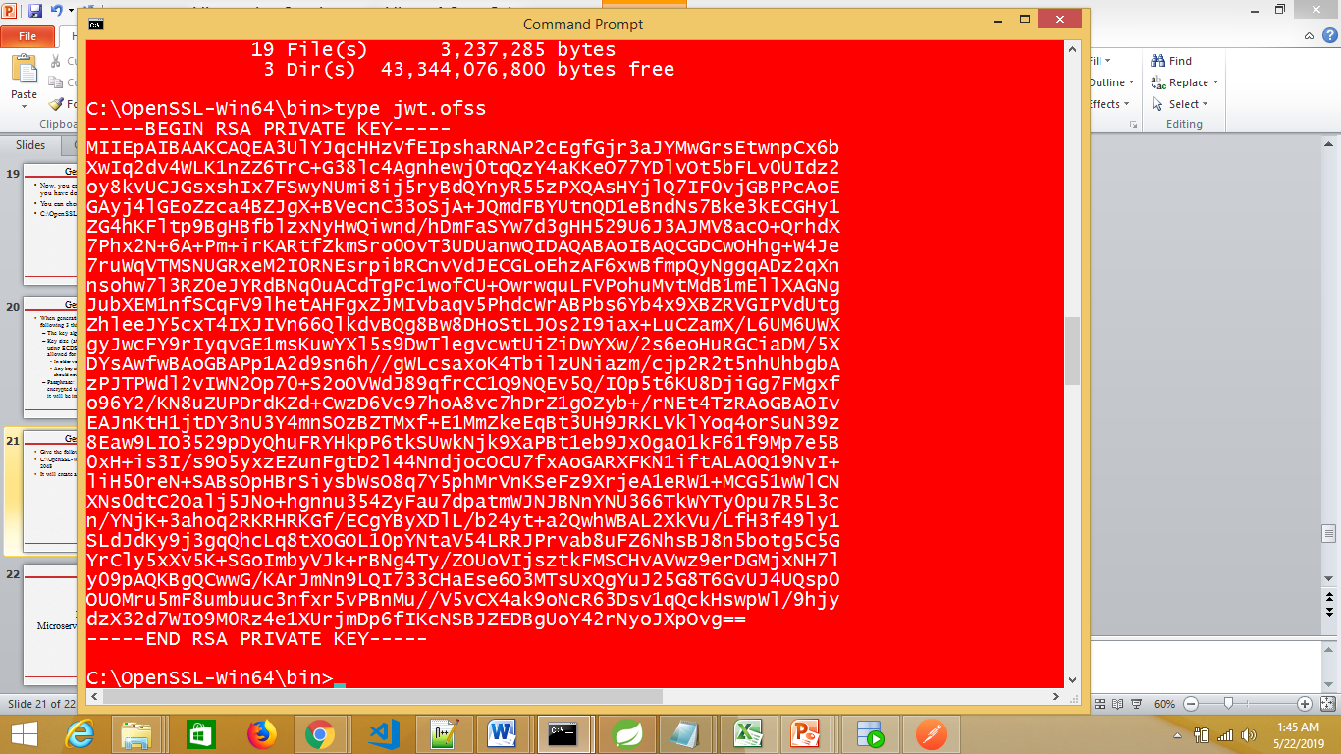
Generating the private key
Give the following command to generate private key:
C:\OpenSSL-Win64\bin>openssl genrsa -out jwt.ofss 2048 & openssl rsa -in jwt.ofss
It will create a file “jwt.ofss” that contains the private key

Slide 25
Generating the public key
Similarly, you can give the following command to create public key
openssl rsa -in jwt.ofss -pubout
-----BEGIN PUBLIC KEY-----
MIIBIjANBgkqhkiG9w0BAQEFAAOCAQ8AMIIBCgKCAQEA546PHuj/sPgBlnPRec/t
1ThRj7ttzb7I22Pn0X6zXKqPM89mMwD3/JqzXd3UQCCUUlcxFlvSEB4h3XZQW0t0
b9V/LkbLtnRKs/7nQ7q5o5oBrhomCrDPt3jmpO+kYnPNR51mNiMXGrGmi/WV5V5N
xnRxTI3ECH3CSZiTbWCOvmhEHhhgzIxcmw9B4k3Na/Oh3EfD5SylsIEsZMgqKo0a
Ib6IlW8m45G04lI0O+17fqi/kugrBT/uMpJ3Oa/Dc7TrbP6eNjzd+TxsQkzhuISV
RIrC8wOrFtYvy7D7u1nSjrAnZnKGd7xM4JBlpU53tzeCkjPqFB0/eRERFGavhxMm
0wIDAQAB
-----END PUBLIC KEY-----

Slide 26
Defining OAuth2 Resource filter order
For the version of Spring Boot latter than 1.5 release, add the below property in your application.properties file to define OAuth2 Resource filter order.
security.oauth2.resource.filter-order=3
OAuth2 resources are protected by a filter chain with the order specified by security.oauth2.resource.filter-order
You can find the order details in the documentation
1 means access_override
2 means basic auth order

Slide 27
Create DB table users
We can use the already created database table “users” in our previous session
You can check:
SELECT * FROM USERS
We just need two columns username and password
So, insert some username and password (BCryptEncoded format)

Slide 28
Run as Spring Boot application
Open postman client
We need to get access token first:
Click on Get new access token
Fill the details in the form
Then click on Request token
It will given you an access token that will be used to access the application

Slide 29
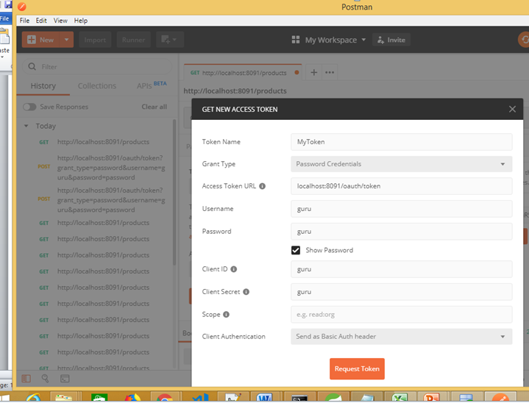
Generating access token

Slide 30
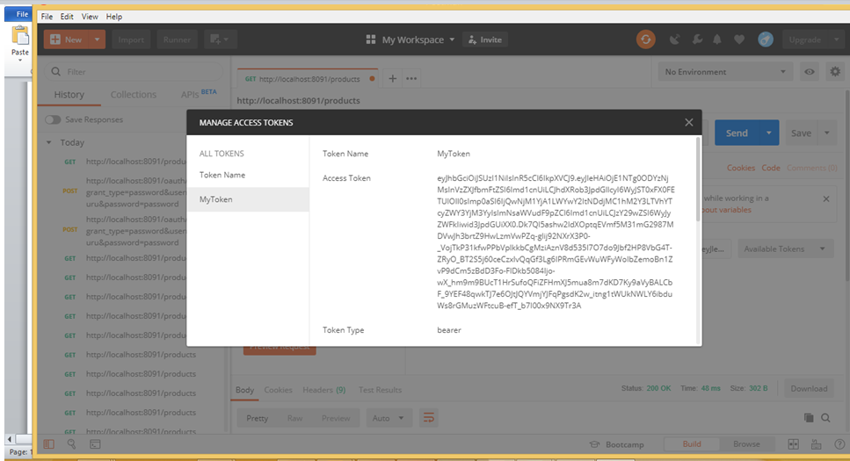
Generating access token

Slide 31
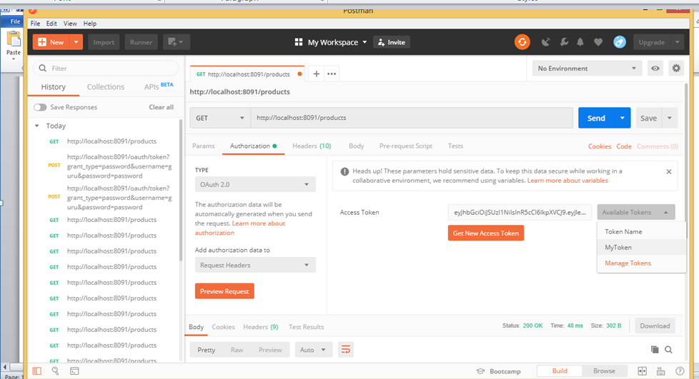
Access the restricted page now

Slide 32
End of Spring Boot Security

